Slide 1


Expert Hacks:
Cracking the Data Science Interview
Anish Mahapatra | 04 April, 2022

Slide 2

Agenda
01
Introduction
02
Why choose Data Science?
03
What is Data Science?
04
Roles in Data Science
05
Move into Data Science
06
Tools & Technologies
Notes:
Expertrons Company Profile: Valuation & Investors | PitchBook

Slide 3











Topic 1 of 6
Introduction
Senior Data Scientist
LinkedIn: www.linkedin.com/in/anishmahapatra Medium: anishmahapatra.medium.com Website: www.anishmahapatra.com
GitHub: www.github.com/anishmahapatra
Q. How to get into Data Science?
A. Simple, ask a real-world Data Scientist.

Slide 4




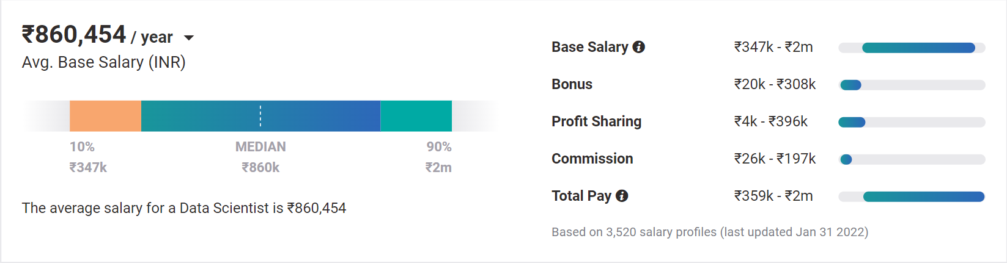
Topic 2 of 6
Why choose Data Science?
01
02
03
Relevance in the future
Business & Technology
Industry-Agnostic
Companies are building and growing in Data and it is the future.
Data Science is a combination of Business, Math and Technology, so growth can be in business / technology
Use your existing knowledge / domain / technology expertise with a data-edge
04
Extremely High Market Demand
Supply-Demand mismatch means companies are willing to pay more
Notes:
Source:https://www.payscale.com/research/IN/Job=Data_Scientist/Salary

Slide 5



Topic 4 of 6
Roles in Data Science
01
02
03
Data Engineer
Machine Learning Engineer
Business Analyst
Data Movement, Building Data pipelines, Quality of Data, Data Governance
Experimentation to get output, Modelling, Making the most out of data, Data Analytics
Client communication & management, Dashboarding & Reporting, Visualization, Decision Making
04
Data Scientist
Data on the cloud, modelling in all capacities, visualization, presentation to stakeholders, team management
Notes:
Source: https://databricks.com/blog/2020/08/03/modern-industrial-iot-analytics-on-azure-part-1.html

Slide 6
Topic 5 of 6
How to move into Data Science
01
02
03
Set Target
Optimize your resume
Build LinkedIn Profile
Decide the kind of roles to target, Talk to people who are doing what you want to do
Understand how ATS works (keywords),
Put keywords in your resume (SEO), Take feedback on resume
Add certifications, Get recommendations Participate in competitions, Do projects,
Keyword Optimization / SEO
06
05
04
Globally Accepted Degree (70%)
Build Relevant Network
Have high standards
Start writing about Data Science, Connect with recruiters, Build a strong base,
Be active on LinkedIn, Medium
Have real interest, Google & know about the latest happenings
You need to know what you are looking for.
Money, growth, industry change, career trajectory, culture
Globally recognized degree, Degree Accepted by MNCs,
Possibility of PhD later,
Alumni Status
Bonus - WES Certification, Teachers from the industry
Notes:
LinkedIn: https://www.linkedin.com/in/anishmahapatra/
Word Cloud: https://monkeylearn.com/word-cloud/
Naukri: https://www.naukri.com/mnjuser/homepage

Slide 7












Topic 5 of 6
Tools & Technologies in Data Science
Data Engineer
Machine Learning Engineer
Business Analyst
Data Scientist

Slide 8





Topic 5 of 6
Resume Optimization (Demo)

Slide 9
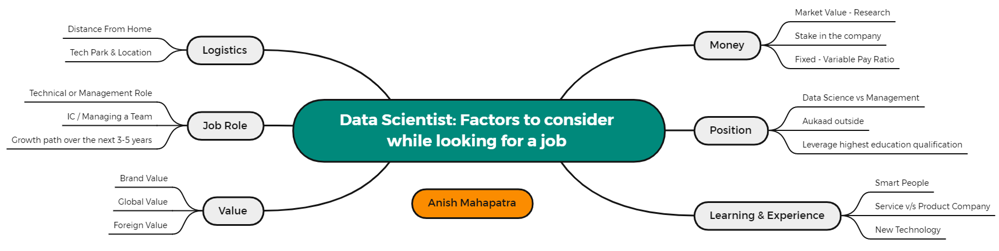
Topic 5 of 6
Factors to consider while looking for a job

Slide 10
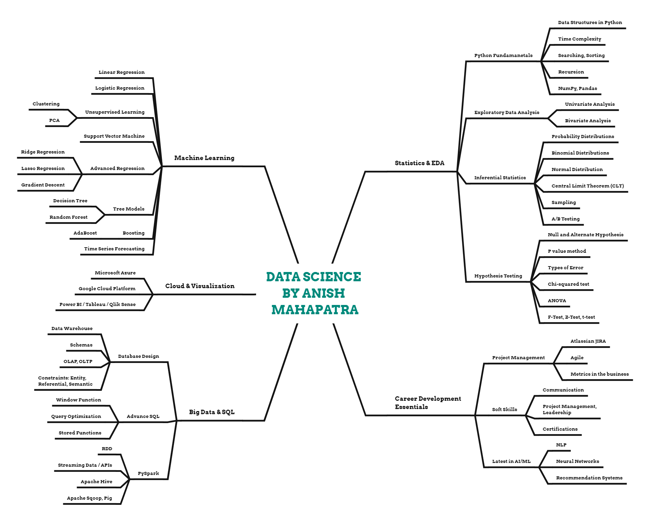
Topic 5 of 6
Plan your Data Science prep

Slide 11
Expert Hacks
01
Have Templates on Notion
02
Send Thank you Email after Interview
03
Have an Interview Tracker
04
Google Top 100 Interview Questions for Data Science, ML, SQL, Python
05
Have a Master’s Degree
06
Be Active & Proactive in replying
Notes:
Expertrons Company Profile: Valuation & Investors | PitchBook

Slide 12
Key Takeaways
01
Introduction - Anish Mahapatra
02
Why choose Data Science? - Be relevant in the future
03
What is Data Science? - Understand end to end
04
Roles in Data Science - DE, MLE, BA, DS
05
Move into Data Science - Detailed Steps to move into DS
06
Tools & Technologies - Defined for the various roles
Notes:
Expertrons Company Profile: Valuation & Investors | PitchBook

Slide 13

Career Road Map in Data Science
Anish Mahapatra
Q&A Session
LinkedIn: www.linkedin.com/in/anishmahapatra
Email: anishmahapatra01@gmail.com

Slide 14
Topic 1 of 6
Introduction
Senior Data Scientist
LinkedIn: www.linkedin.com/in/anishmahapatra Medium: anishmahapatra.medium.com Website: www.anishmahapatra.com
GitHub: www.github.com/anishmahapatra
Q. How to get into Data Science?
A. Simple, ask a real-world Data Scientist.

Slide 15
Career Road Map in Data Science
Anish Mahapatra | 8 November, 2021
Q. How to get into Data Science?
A. Simple, ask a real-world Data Scientist.
Email: anishmahapatra01@gmail.com
Thank you.

